Slide 1

HANDS-ON WITH REACT

Slide 2
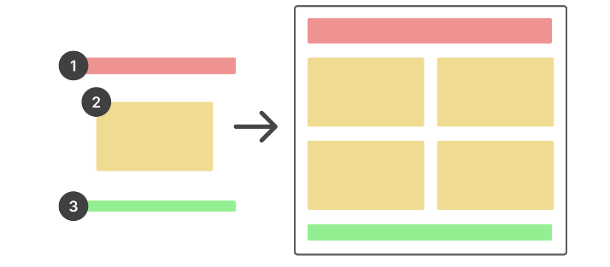
React Overview
What is React?
A JavaScript library that allows you to build user interfaces (UIs) out of a hierarchy of “components”.
Widely used - Facebook, Instagram, Reddit, Twitter, Netflix, Airbnb, BBC, and many more use React for their user interfaces.

Slide 3
React Overview
Why React?
It’s approachable. Anyone with an understanding of JavaScript and HTML can pick up React.
It’s composable. Building your UI with reusable components makes your code simpler, more logical, easier to read, and less repetitive.
Creating dynamic, interactive applications becomes much easier thanks to React features like state.
Its rich ecosystem of community-created tools helps to make your life easier.

Slide 4
Props

Slide 5
React props
Props are React’s way of passing information to a component.
Like how an <img> tag in HTML can accept attributes like “src” and “width”, React components can accept data in the form of props.
Props are incredibly useful for creating reusable components.

Slide 6
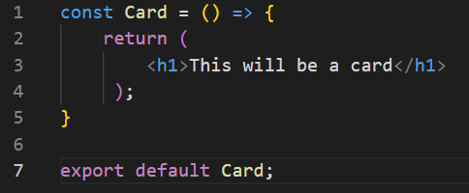
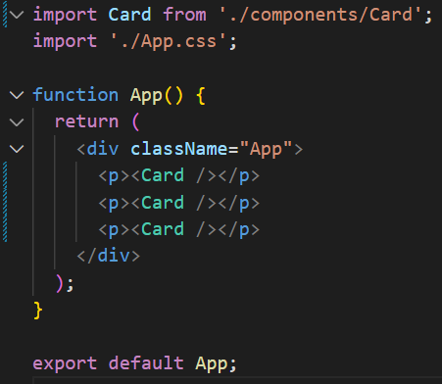
React props
I can create a component which can be reused time and time again

Slide 7
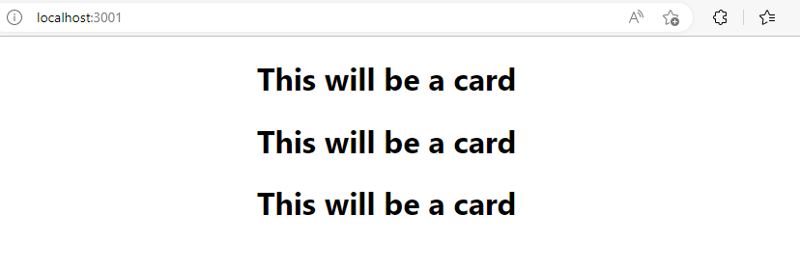
React props
This creates a predictable output

Slide 8
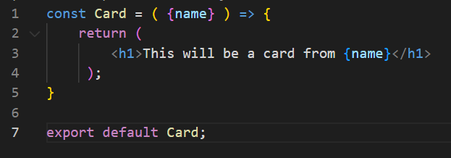
React props
Props allow us to pass data to a child component and then have it used and re rendered based on the content we have given it.
For example, I can add a parameter to the function and then use it in the return, just like JS
This now requires information to be passed with the call. It will be deconstructed like a map

Slide 9
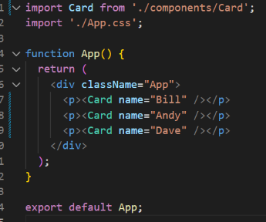
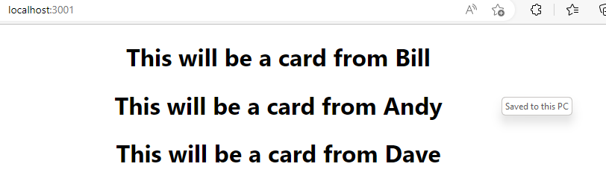
React props
Adding this as Props to the call allow it to be returned and rendered in the App
Notes:
The component is now completely reusable and will simply return the information that was passed in

Slide 10
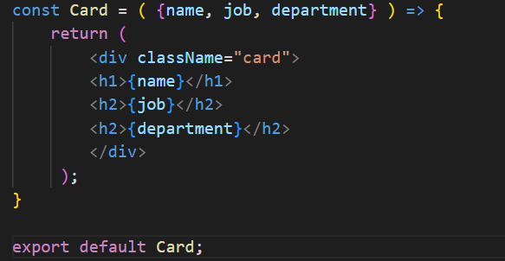
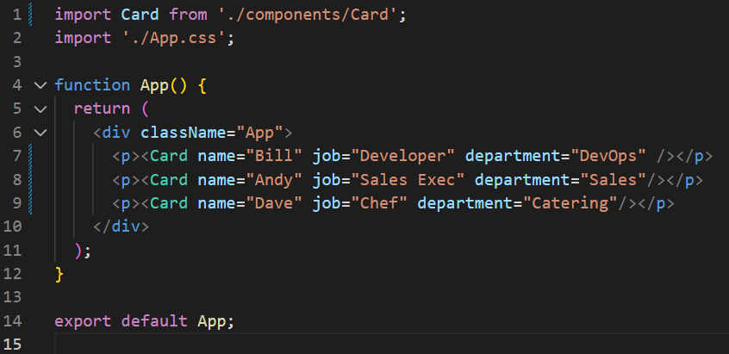
React props
We can now change this content and pass more than one Prop to the component call.
Notes:
The component is now completely reusable and will simply return the information that was passed in

Slide 11
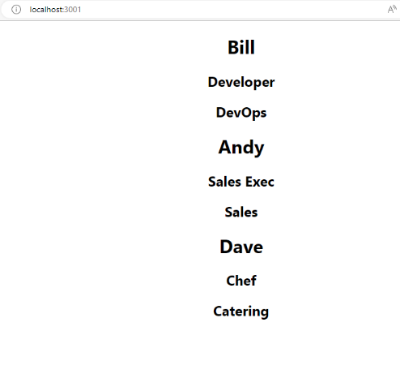
React props
We can now change this content and pass more than one Prop to the component call.
Notes:
The component is now completely reusable and will simply return the information that was passed in

Slide 12
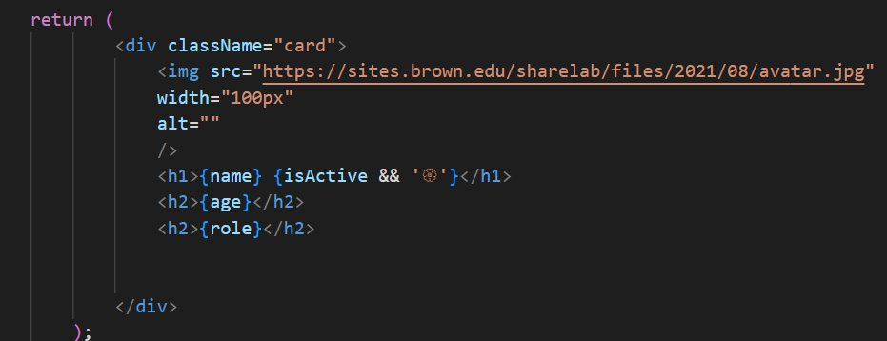
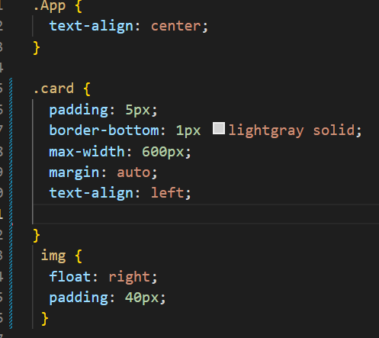
React props
Lets add an image and edit some CSS:
App.css -
Notes:
Image put at the Top and the content Arranged with CSS

Slide 13
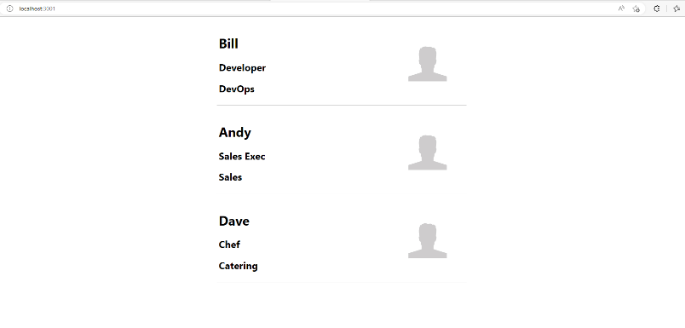
React props
Gives us this:
Notes:
Image put at the Top and the content Arranged with CSS
"https://pedodoctor.com/custom/images/dr-jeffries.jpg“ – Image source

Slide 14
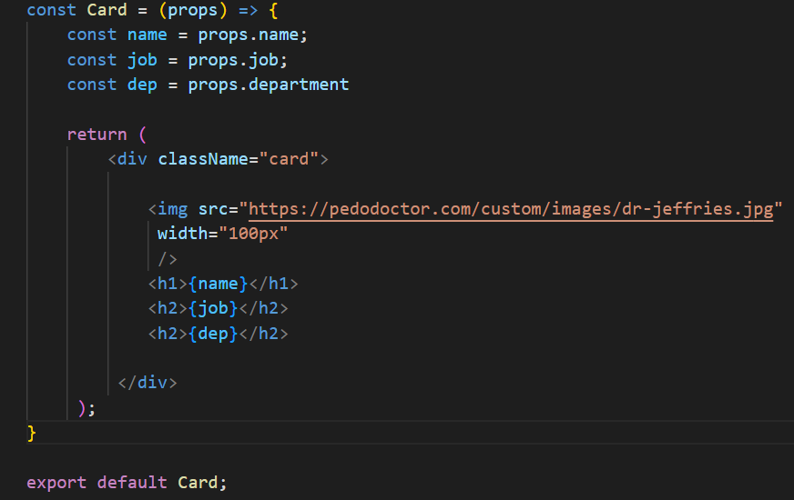
React props
We can also pass the Props in and deconstruct them within the function itself
Notes:
This is how we drag content in with arrays in react and JS. More to come on this later

Slide 15
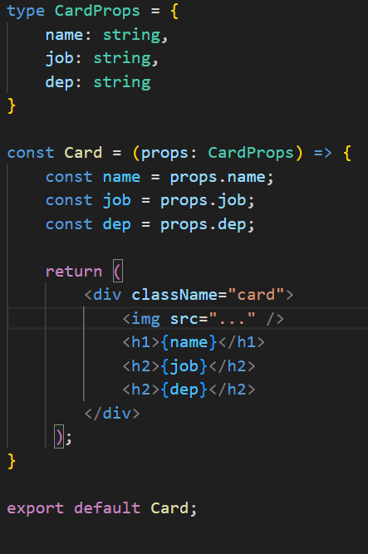
React props – type checking
We can use TypeScript to enforce type checking on props
Notes:
Use type to create a custom type for the props. This enables intellisense when importing the component and will enforce type checking when setting props on the component.

Slide 16
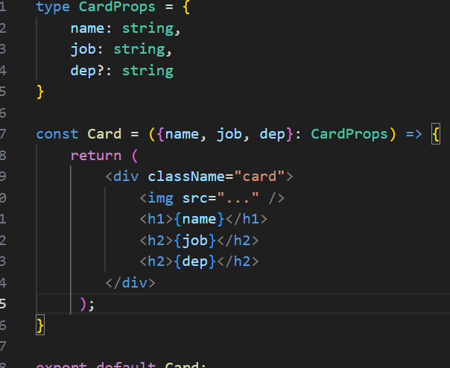
React props – type checking
We also use destructuring to save on code.

Slide 17
QuickLab 3
Working with Props in react

